Slide 1

Opentomany
Team:
Achieverscorner

Slide 2
The flow of the web app
Landing page
This is the beginning of the web app
Login
Users can login using their google accounts or default sign-in.
Community
A community of young developers
Training and the valuable review by experts
Opensource contibutions are must
Guidance
Opensource
Learning
Hackathons
A university in itself, training the aspirers to innovate and foster learning
A blast of information regarding various hackathons

Slide 3
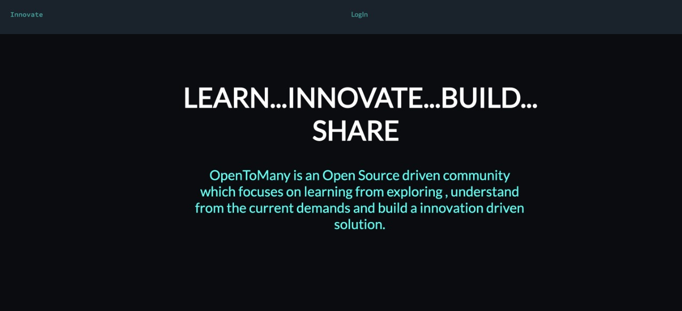
Opentomany

Slide 4
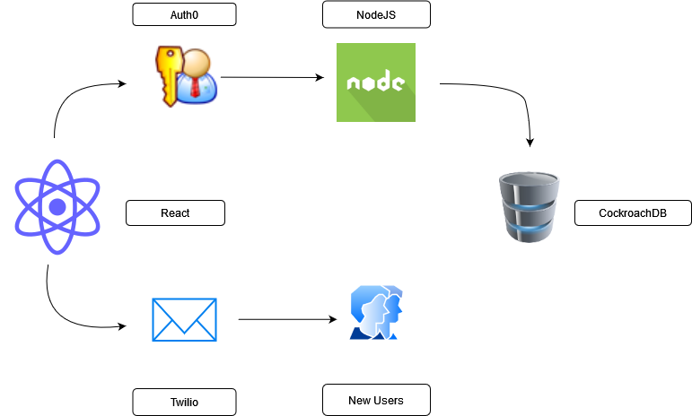
An overview of the project

Slide 5
OpenToMany is an opensource project build to foster ideation and innovation among the young developers of the country. It aims to connect the people and exchange ideas, Learn from the fellow peers and experts, and also finding a hackathon and work collaboratively. With that being said, we have the following sections

Slide 6
Community
Community: This part of the project aims at connecting like minded people and exchange their ideas. This not only aims to connect the young developers, but industry experts too.

Slide 7
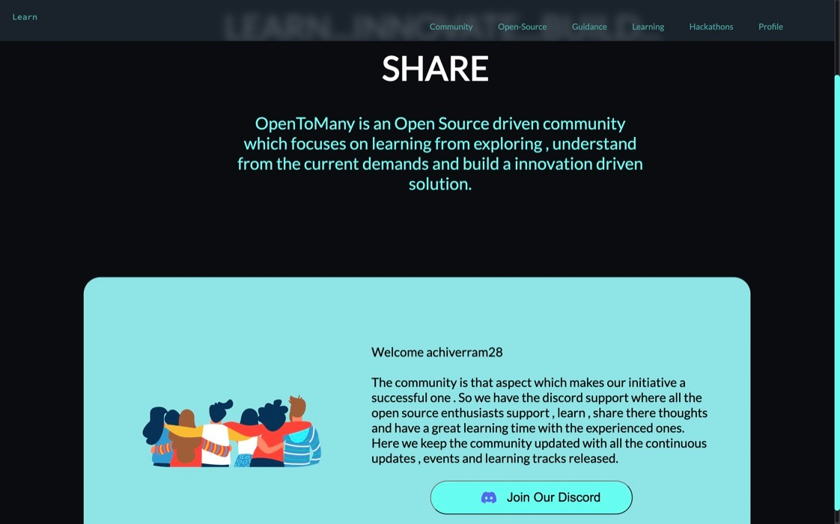

Slide 8
Opensource
Opensource is the best way to learn! Keeping that in mind, this subproject aims to deliver the knowledge and help people to learn more about the opensource contributions.

Slide 9
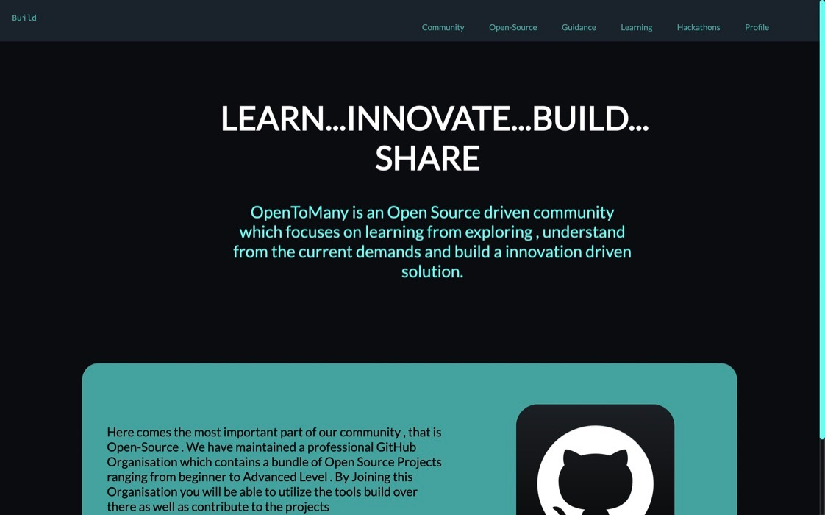

Slide 10
Guidance
Want some help or reviews? Don’t worry we got it covered.
OpenToMany helps students to connect to the industry experts. Where the aspirers can seek suggestions and expert guidance regarding their projetcts
They can also get update themselves with the current market trends.

Slide 11
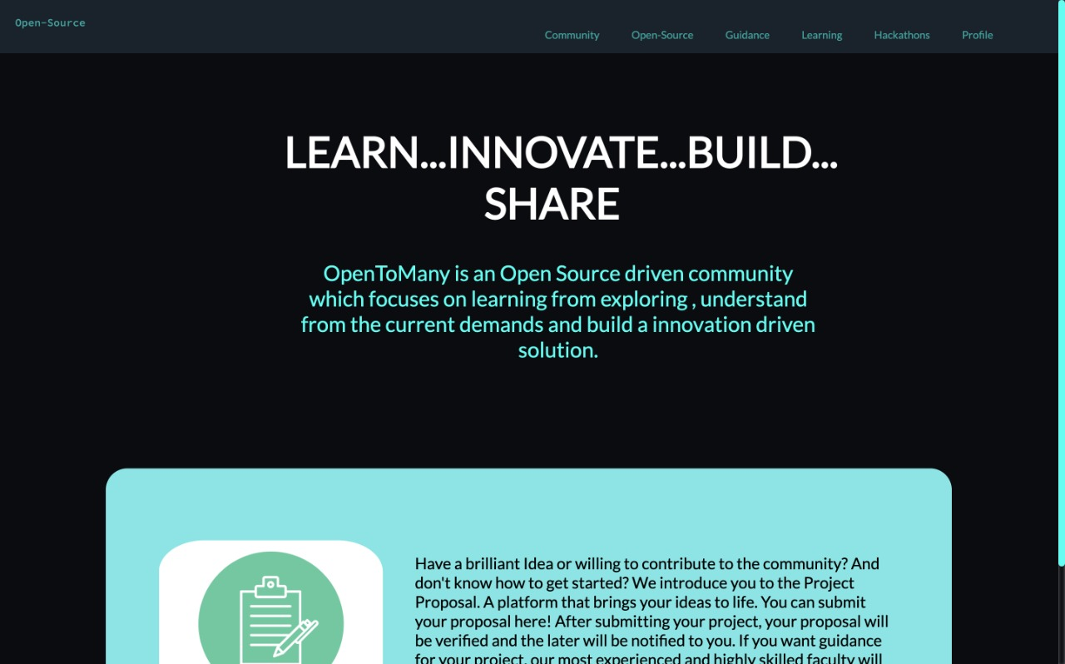

Slide 12
Learning
Learning and collaboration is super fun!
To get the developers updated, we offer learning tracks. Here, a person visit the webpage and start learning effortlessly.
The learning track has:
HashNode
Youtube
The Women Techmakers Community
Auth0
CockroachDB
Twilio

Slide 13
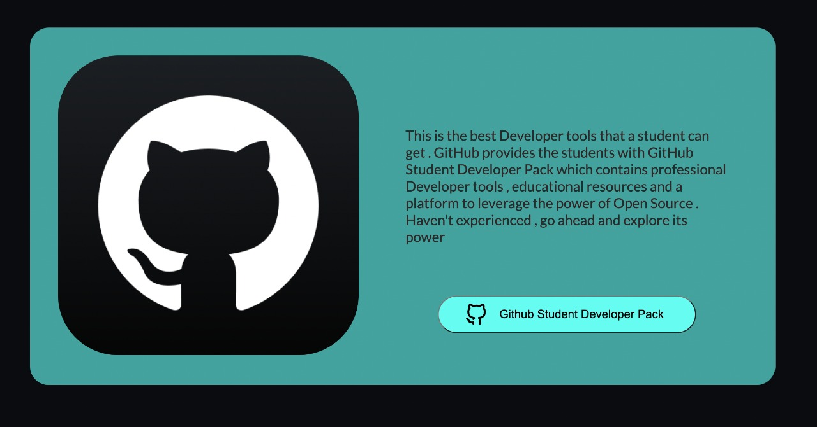

Slide 14
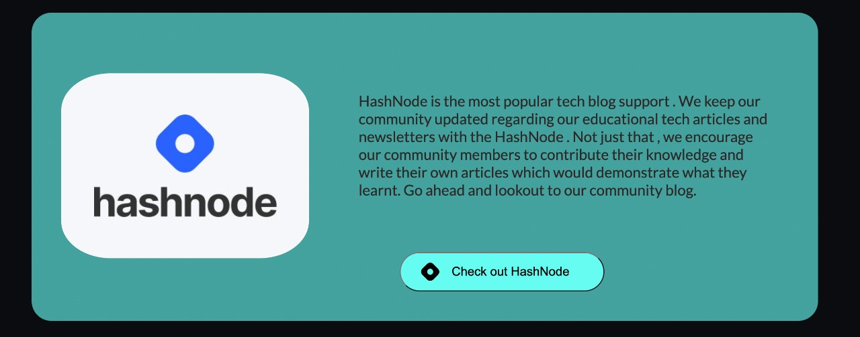

Slide 15
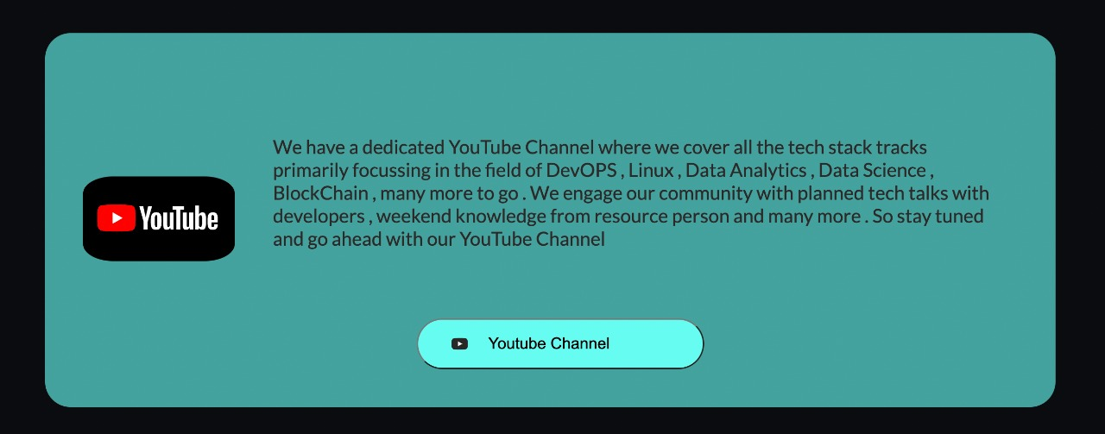

Slide 16
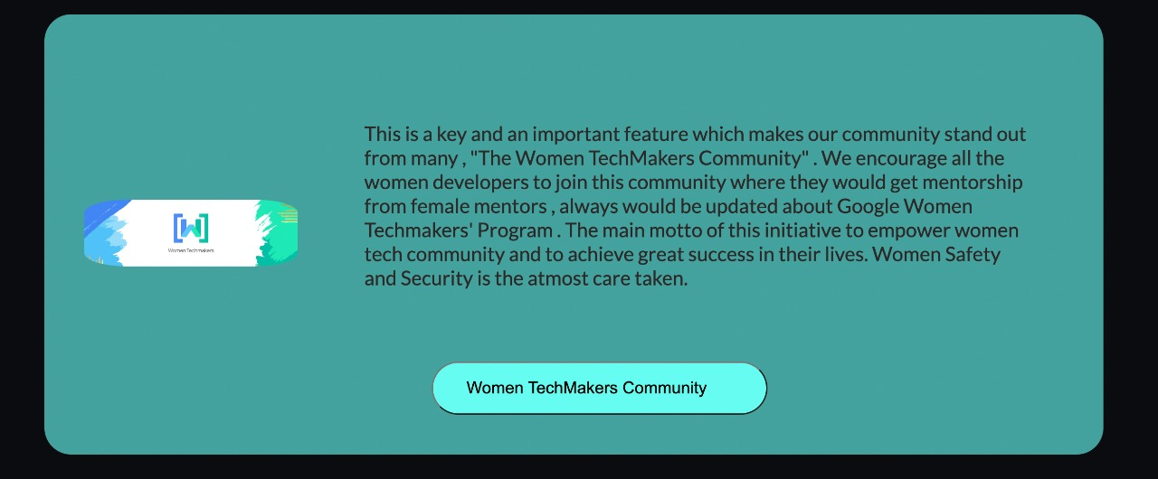

Slide 17
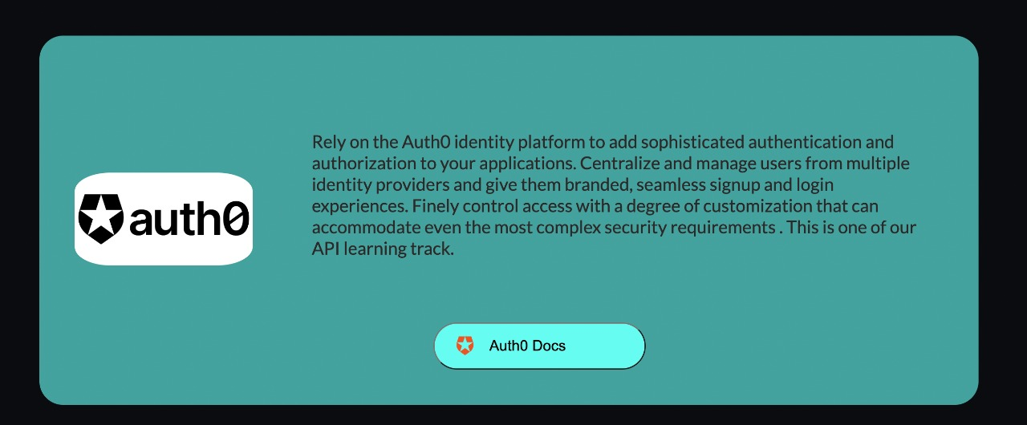

Slide 18
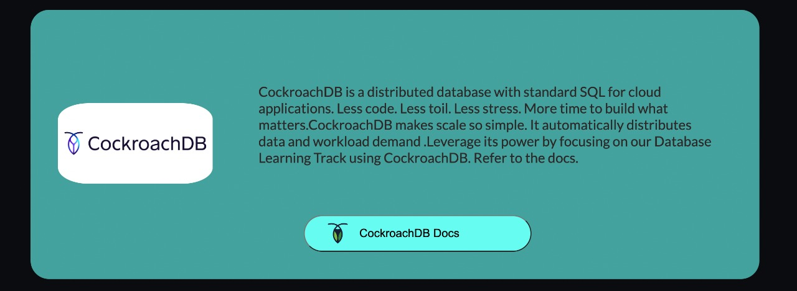

Slide 19
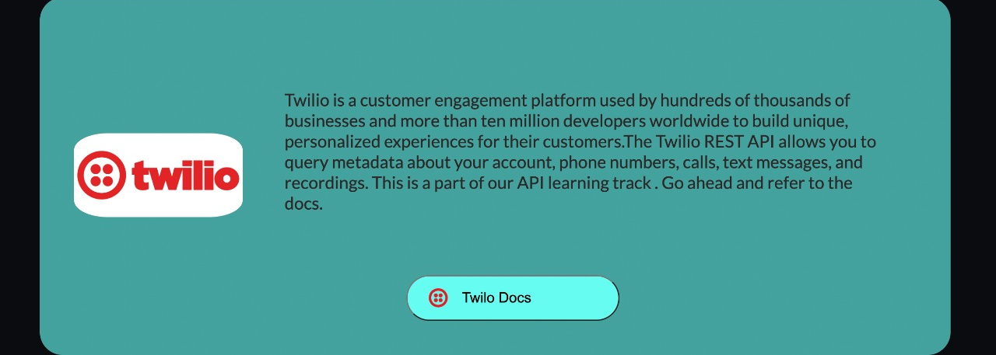

Slide 20
Hackathons
Applying the knowledge is very important. Hence, OpenToMany helps the people to find various hackathons.
Complete hackathon details including the date, location and the official will be provided to the young developers.
Here, we also aim to connect the people for finding their teammates, an hackathon management dashboard and the mental stability support to all the participants.

Slide 21
What makes this project unique?
This project aims to cover everything which is entirely unique in the market, which includes all the necessary requirements for exceling in the field of open source. By providing the mental stability support to all the participants and empowering the women developers.

Slide 22
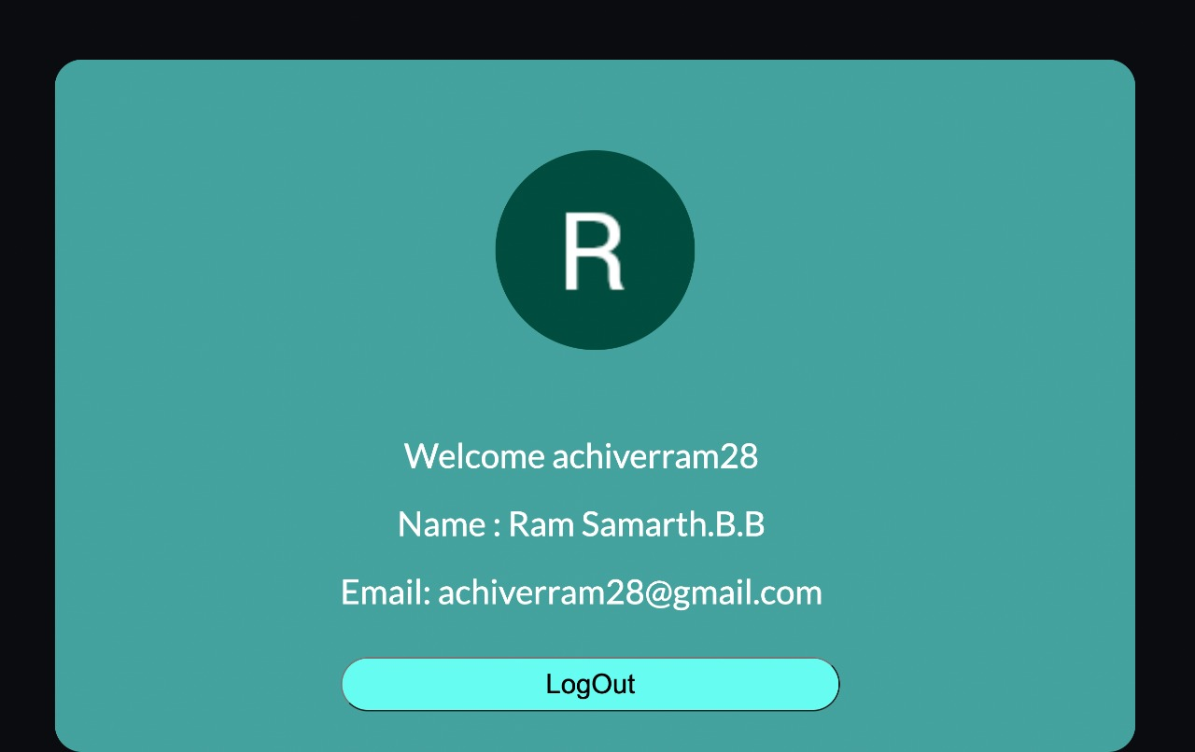
Profile Dashboard

